Slide 1
Elixir Beginnings
The joy of elixir
Notes:
Saibaba Vinayakaya Namaha! Saraswati Devi

Slide 2


Thank you for the opportunity!
Amazing community.
Please donate.
Thank you, sponsors!

Slide 3


Sameeri Marryboyina
Software Engineer
The university of oklahoma
Hyderabad, India

Slide 4

Join our Team!

Slide 5
TALK GOAL
For the Love of Elixir
To excite you and build an interest in Elixir, Erlang

Slide 6
Gedanken's Karte
People
Problems
P. Languages
Paradigms
Principles
Patterns
Practices
Productivity
Tools, libraries, frameworks
My mind map to Software Engineering

Slide 7
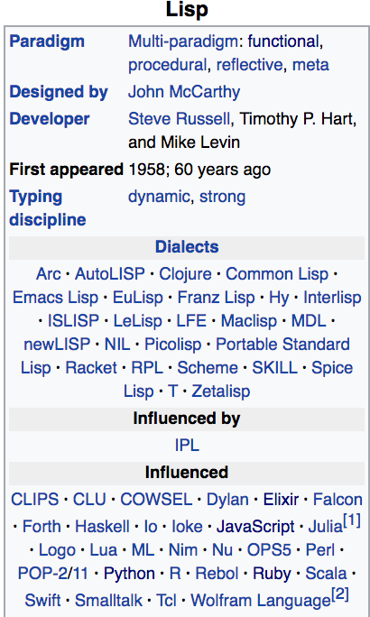
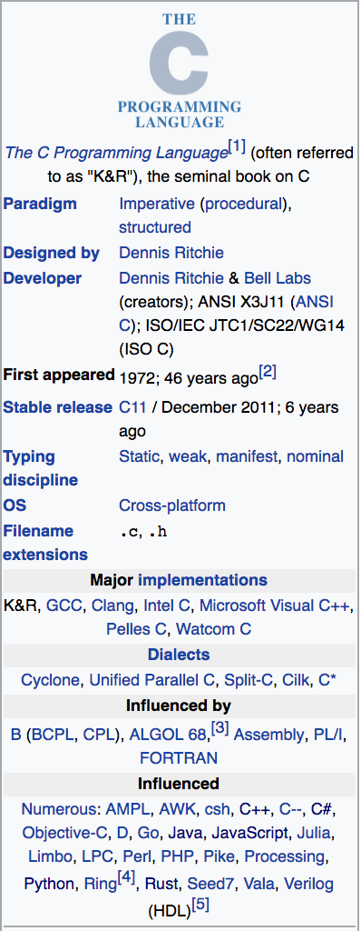
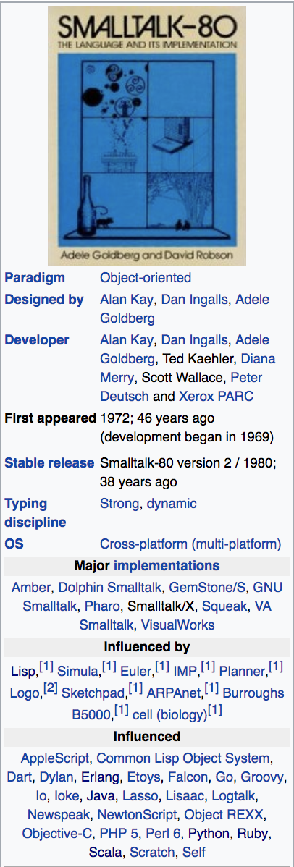
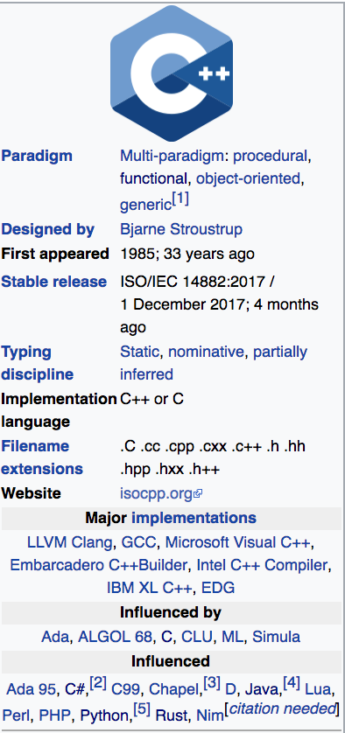
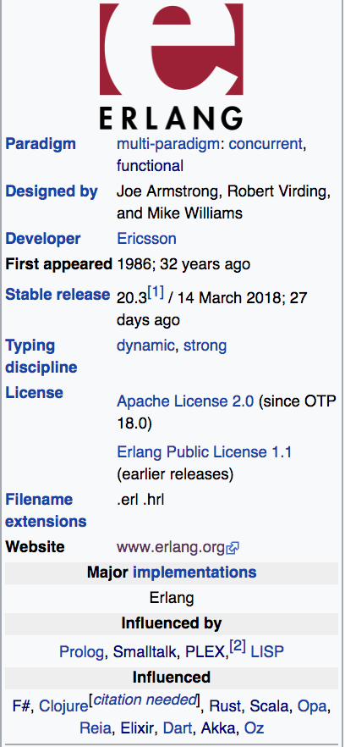
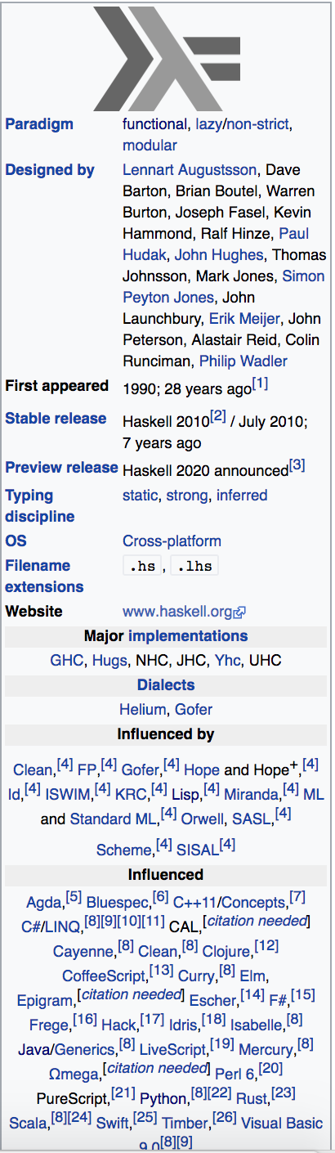
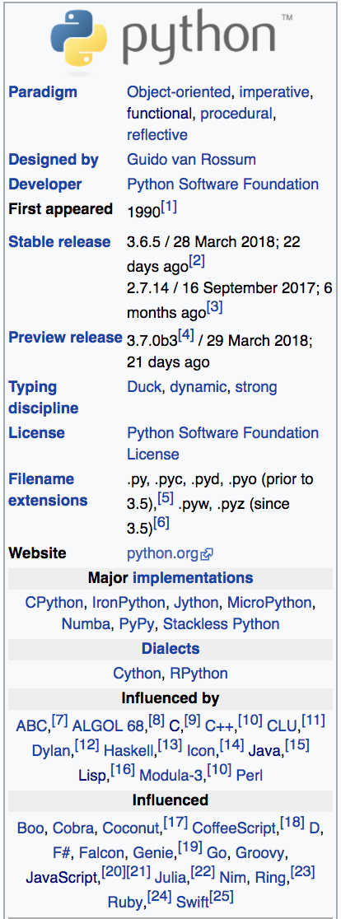
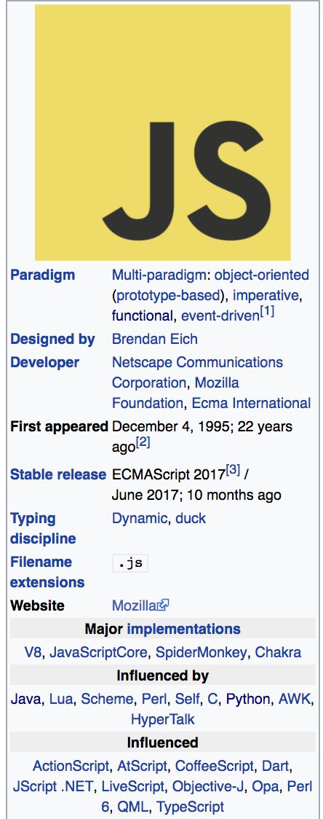
Language Characteristics
Creators, Paradigms, Typing Discipline, Influenced by, Influenced

Slide 8
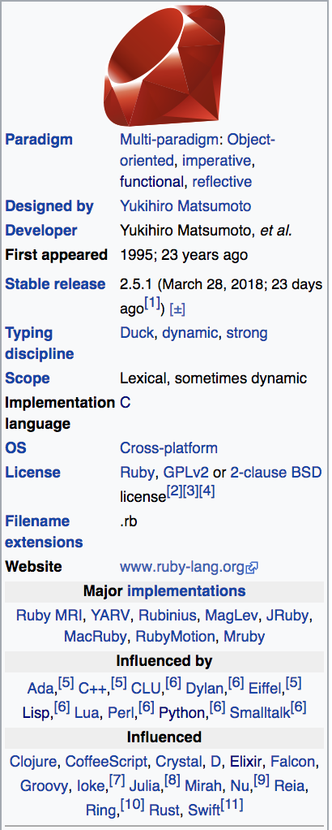
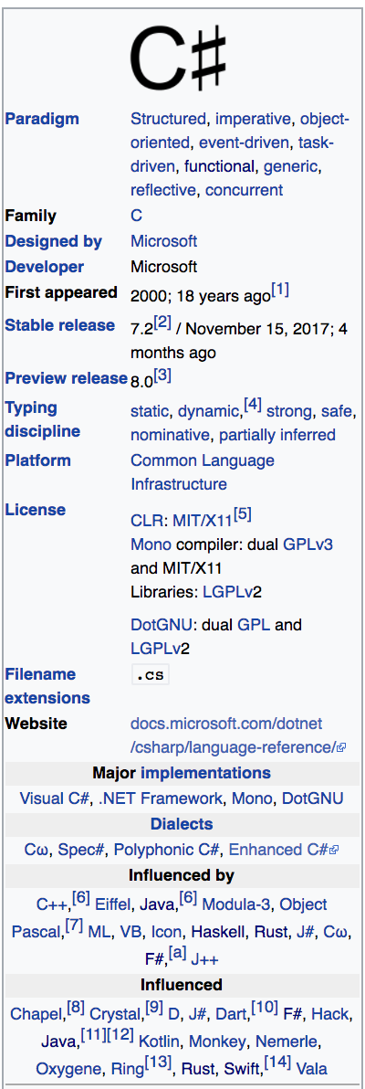
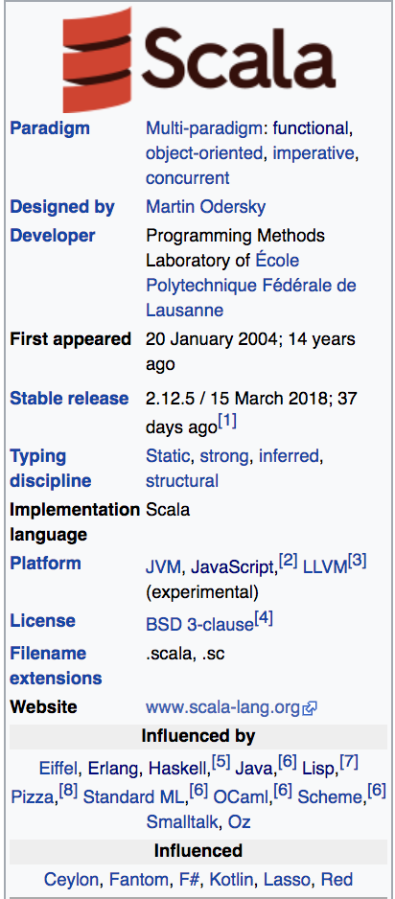
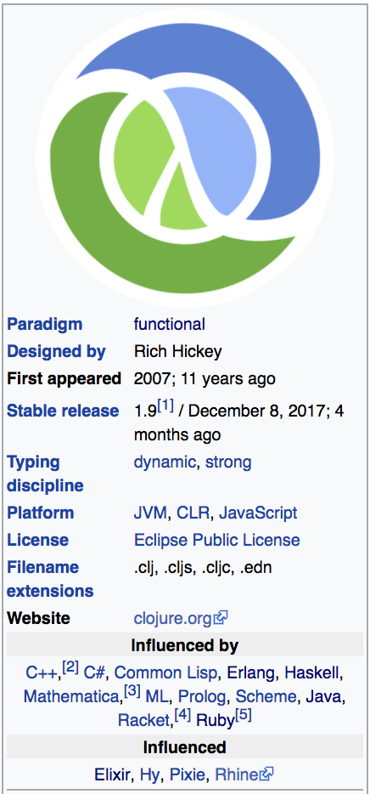
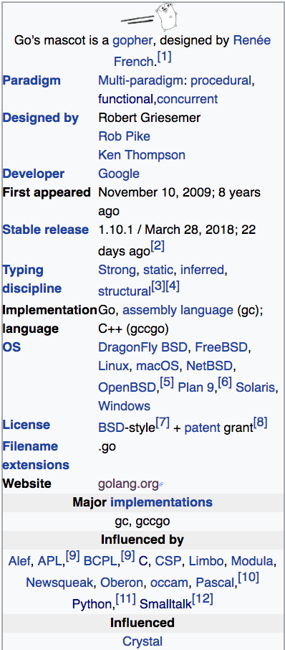
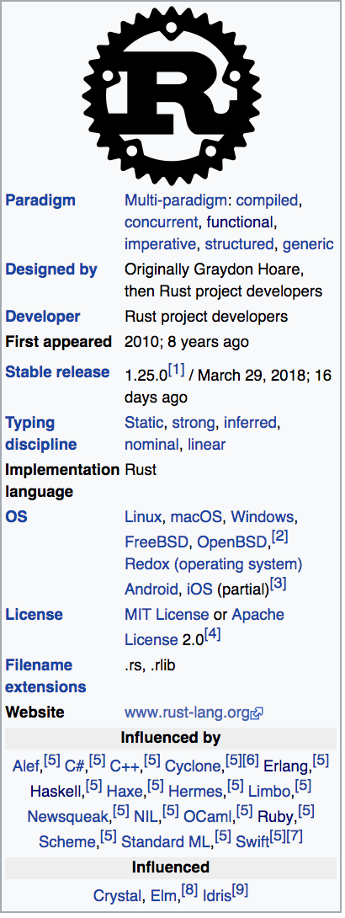
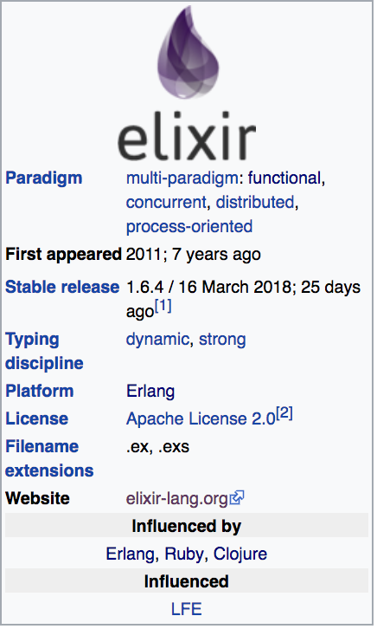
Language Characteristics
Creators, Paradigms, Typing Discipline, Influenced by, Influenced

Slide 9
What it means to be a Language...
What problem are we solving?
Nature
A language is a tool.
Problems and Contexts
We want to use the right tool for a given problem
Communication
Phillosophy
Alphabet
Constructs
Syntax
Semantics
Type System (Static vs Dynamic)
Translation Model (Compiled vs Interpreted)
Paradigms
Execution model
Runtime Mechanics
Specification
Implementation

Slide 10
Key Takeaways
Languages influence one another
Each paradigm presents a way to think about the context and the problem
Some problems are solved by many languages. This is good. We have choices.
Modern languages manage memory for us.
People are opinionated.

Slide 11
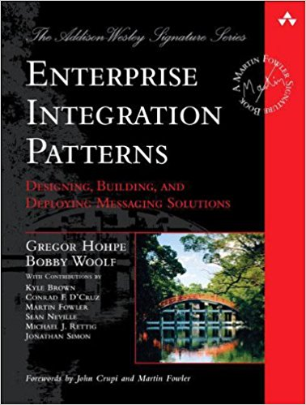
Enterprise Integration Patterns
How do we connect Systems across multiple machines?
We need special components to make systems talk to each other.
What are the patterns/vocabulary?
Message Oriented Architecture/ Message based Systems
The core construct is a "Message".

Slide 12
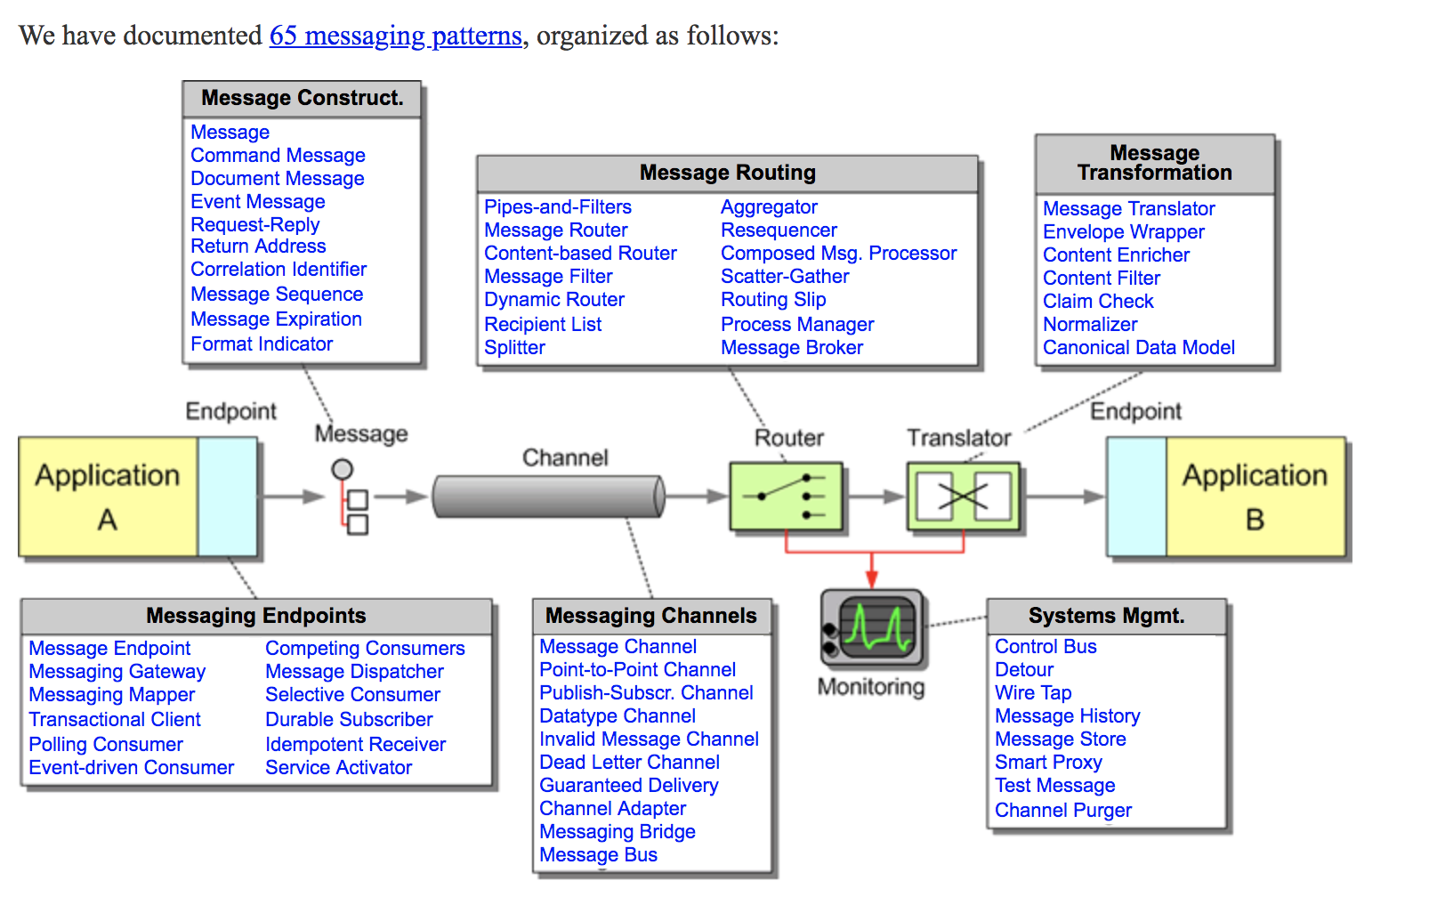
http://www.enterpriseintegrationpatterns.com/patterns/messaging/

Slide 13
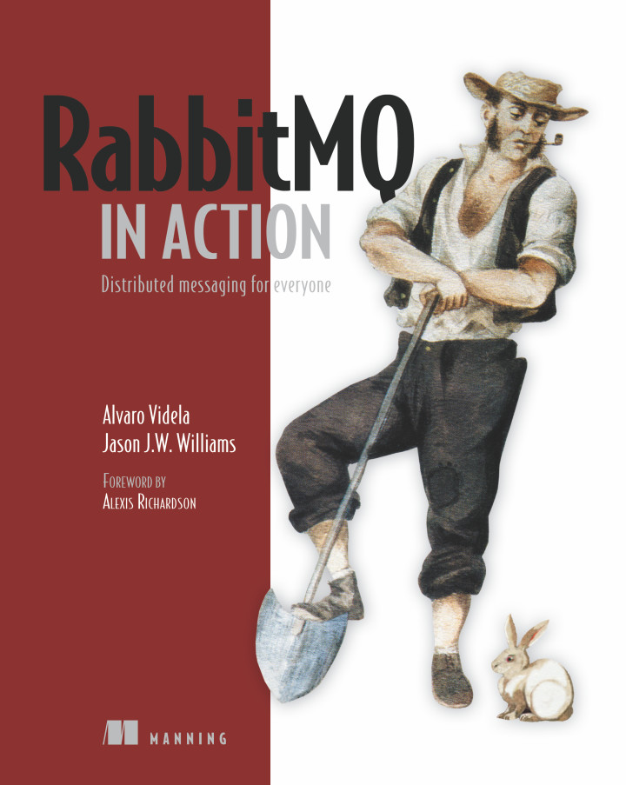
RabbitMQ
Message Broker
JP Morgan Chase
AMQP
ERLANG

Slide 14
ERLANG USERS
RabbitMQ
CouchDB
Watsapp
AdRoll
Basho Riak
Klarna
Amazon SimpleDB

Slide 15
INSPIRED BY ERLANG, ACTOR MODEL
Akka
Service Fabric

Slide 16

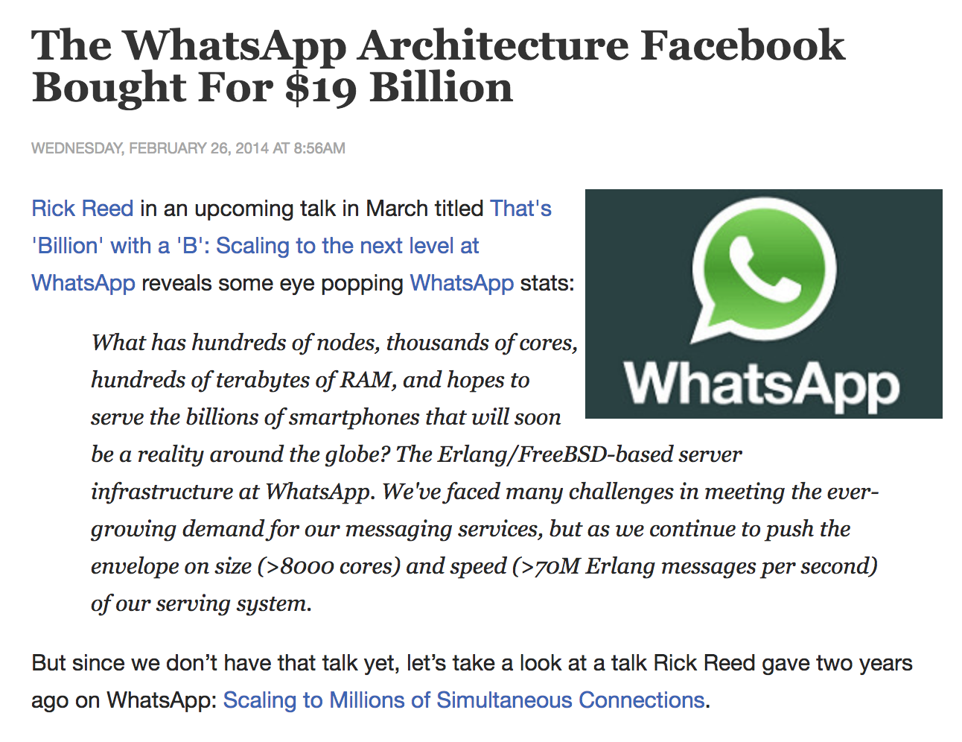
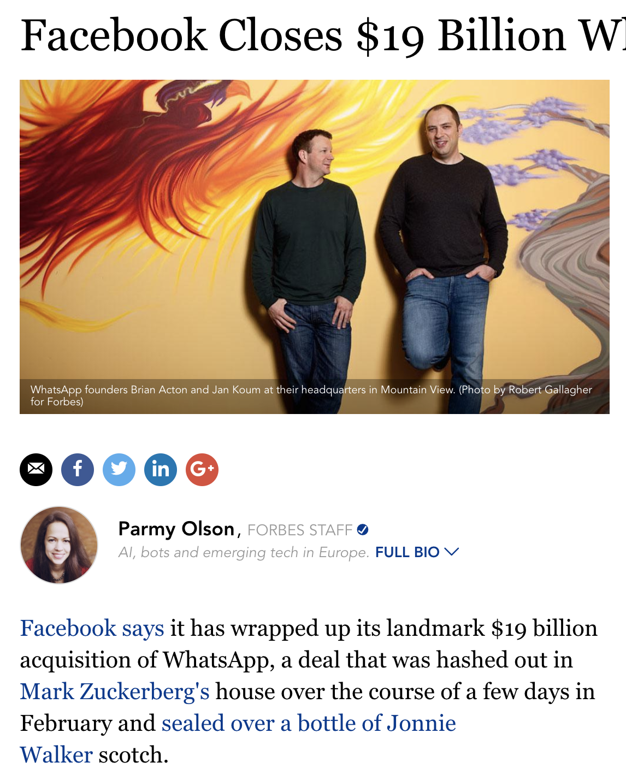
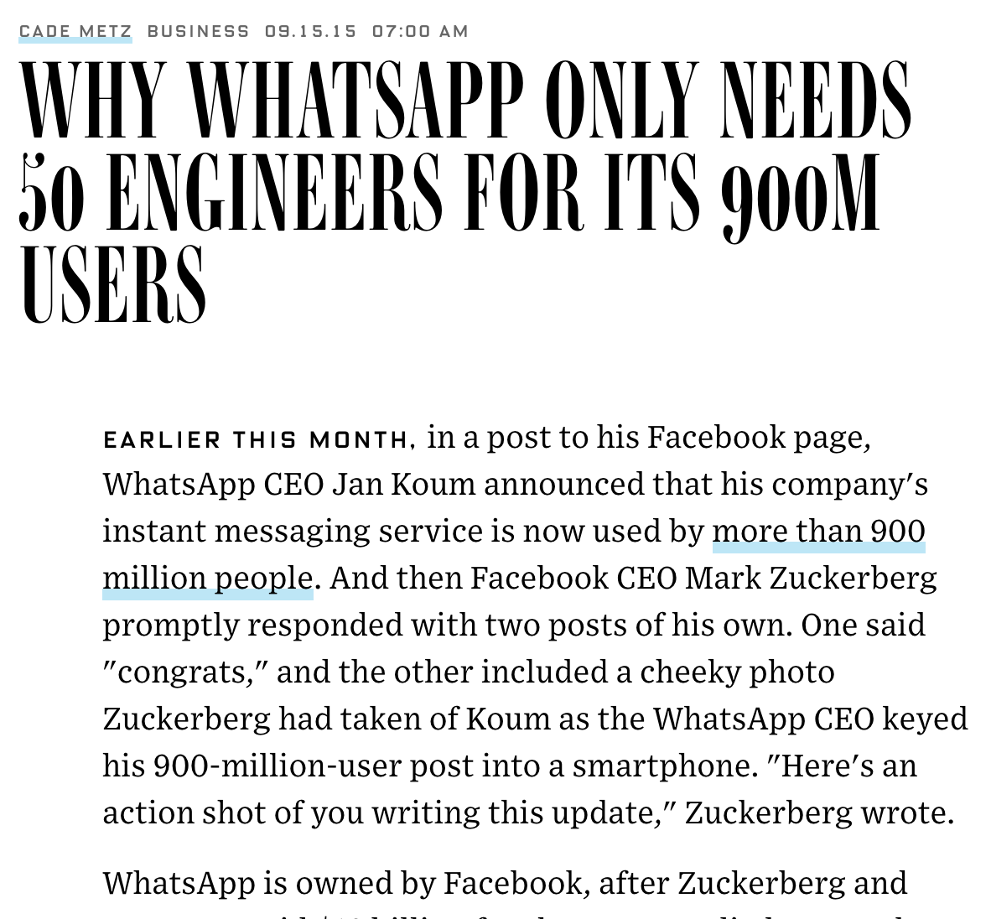
The Watsapp Story

Slide 17
ELIXIR HISTORY

Slide 18
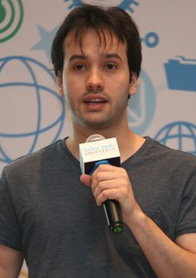
JOSE VALIM
Brazilian Engineer
Ruby on Rails Core Maintainer

Slide 19

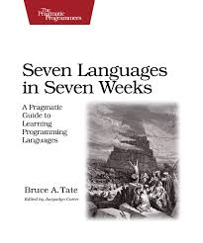

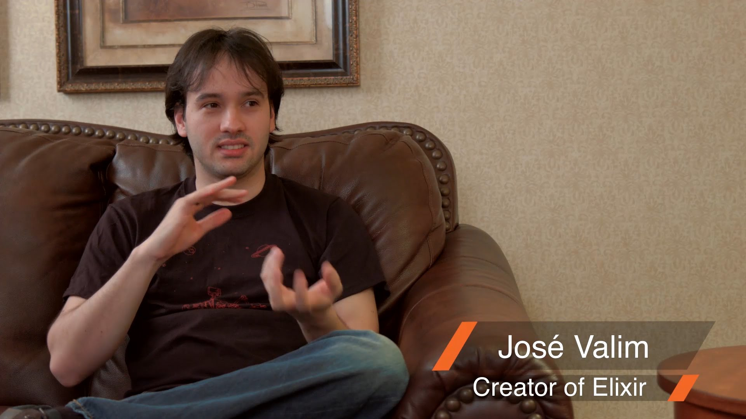

3. Researches alternate technologies, languages for high-scalable systems
4. Discovers Erlang via Seven Languages book
2. Investigates scalability with concurrency. Thinks threads are not cool!
6. Misses tooling based productivity
5. Learns and works with Erlang. Loves it.
1. Jose' Valim
Ruby on Rails Core maintainer
7. Implements Elixir to have all of Erlang's advantages, but with added productivity.

Slide 20
ERLANG HISTORY

Slide 21
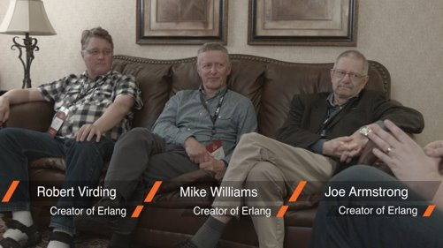
A history of Erlang – JoeArmstrong
http://webcem01.cem.itesm.mx:8005/erlang/cd/downloads/hopl_erlang.pdf

Slide 22

The CS Lab
http://webcem01.cem.itesm.mx:8005/erlang/cd/downloads/hopl_erlang.pdf
Ericsson – Stockholm, Sweden
Bjarne Däcker brings along Mike Williams
1983 – The CS Lab is established
State of the Art – AXE telephone exchange written in a proprietary language PLEX
Hire Joe Armstrong, Rob Virding
Bjarne Däcker to the team : "Solve Ericsson's Software problem"
Investigate various languages.
Go to conferences – Ask questions about Failure
Look at University papers.
Have access to a VMS, telephone switch, and UNIX.
Joe starts with Smalltalk.
Develops his own hand-written graphic notation for basic telephony.
Roger Skagervall looks at Joe's algebra and introduces him to Prolog.
Joe starts working in Prolog.
He develops a meta-interpreter in Prolog.
The meta-interpreter starts to grow in size.
Joe wants to add concurrency.

Slide 23
The team
What sarts as an experiment in “adding concurrency to Prolog” becomes more of a language in its own right.
This language acquired a name “Erlang,”
Deliberately encourage the ambiguity in the name – ERricsson's LANGuage vs Agner Krarup Erlang
The meta-interpreter gets a name – JAM (Joe's Abstract Machine)
Develop a philosophy - Concurrency Oriented Programming
Robert Virding wants to play with Joe's code.
Both review, argue and improve the code.
Rob works in Parlog, in parallel. And he builds his own system.
Introduce Erlang to users.
Collaborate with users. Train them. Remove language features if not necessary.
Work with The University of Uppasla. (Fondly referred to Uppasla boys)
Go to conferences, give talks.
Write a book.

Slide 24
BEAM
A new system called AXE-N gets started.
C++ is used to program the AXE-N.
The project fails. Miserably.
A new Erlang team gets started on it.
The team change priorities from promotion to writing code.
Prolog based implementation is slow.
A C based implementation is created. TEAM(Turbo Erlang Abstract Machine)
Somehow, the name changes from TEAM to BEAM(Bogdan's Erlang Abstract Machine)
The team realize that they need a suite of principles, best-practices, conventions, tools, abstractions.
A new Product team called OTP is formed, since resources with the Erlang team are limited.

Slide 25
Bluetail, AB
Political reasons drive Erlang to be banned for internal usage.
Later, they open source Erlang with some influence from Jane.
All the original people of the team leave and form Bluetail AB with Jane as CEO.
They use the experience, and Erlang to build internet based products.

Slide 26
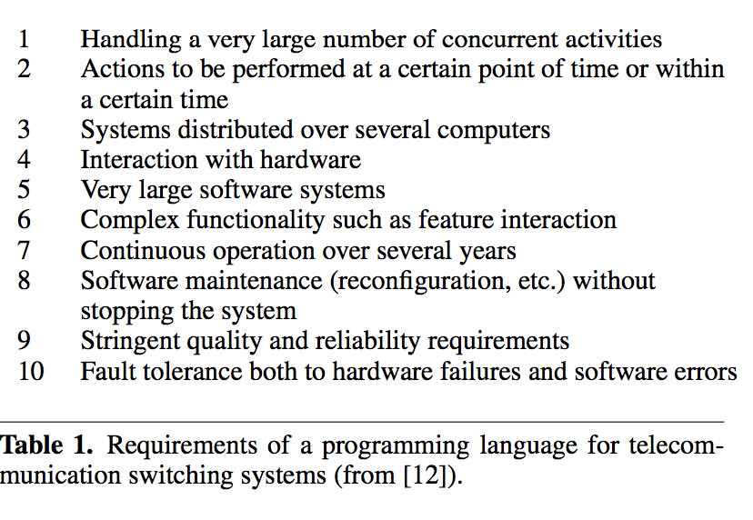
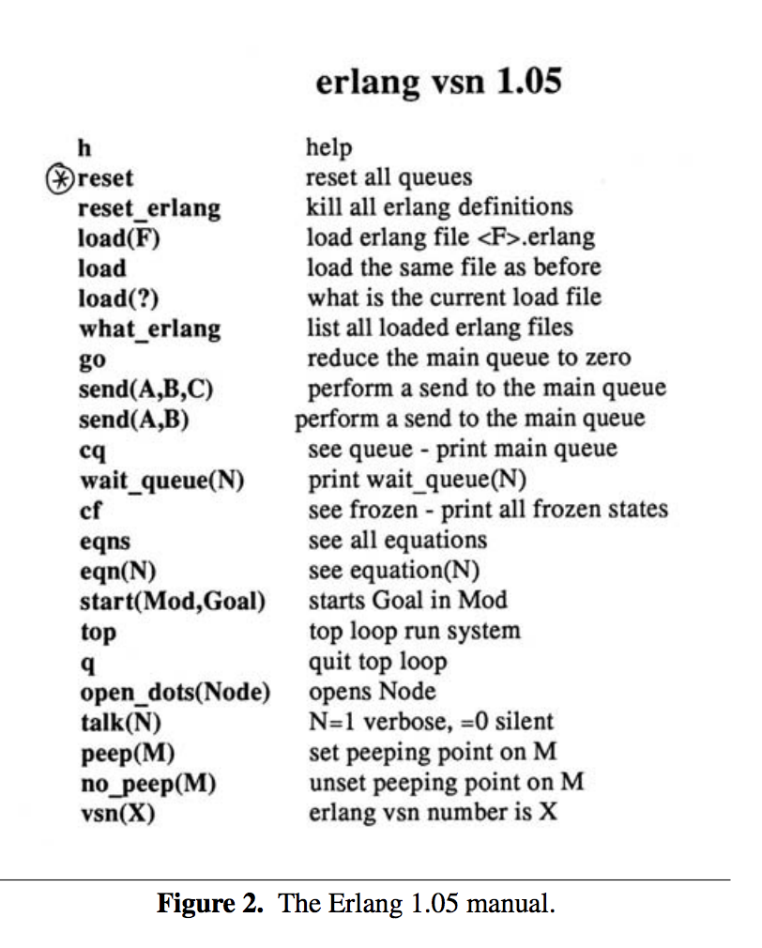
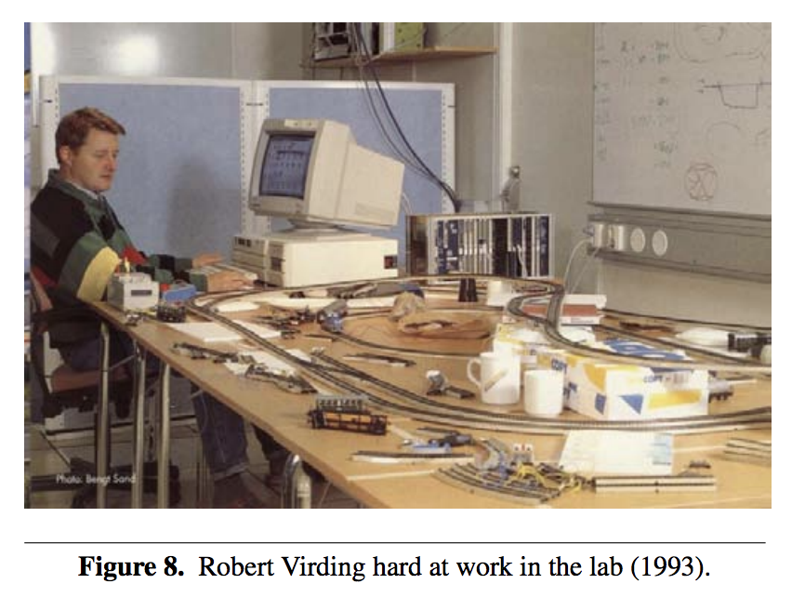
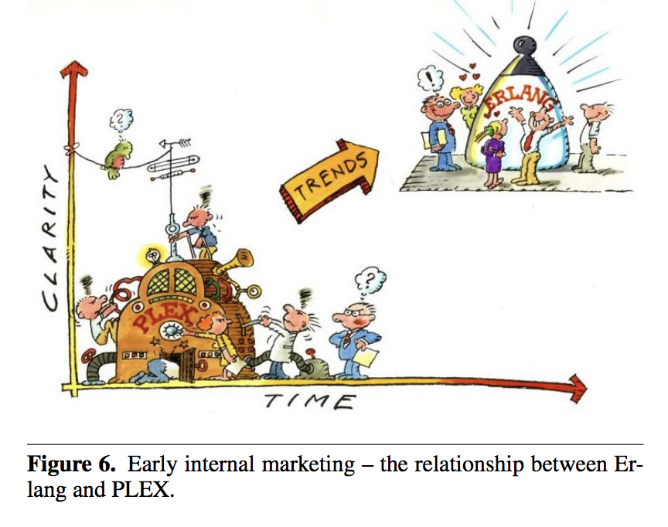
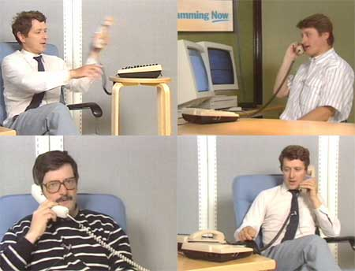

Slide 27
THE ACTOR MODEL

Slide 28
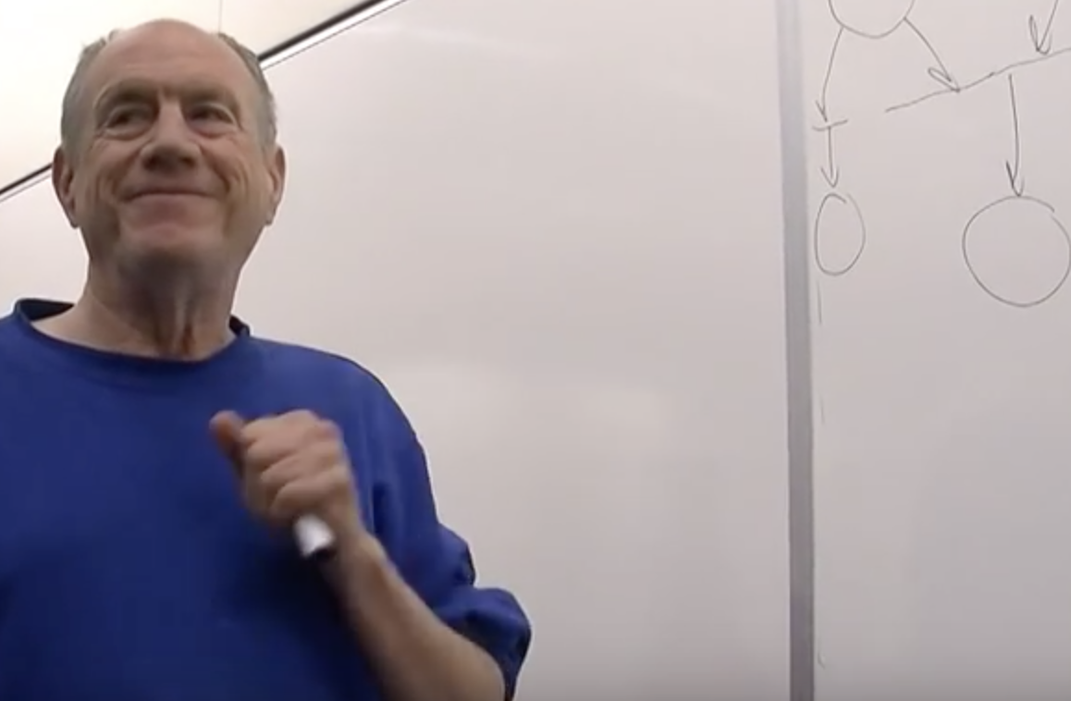
"Carl Hewitt explaining the Actor model” - https://www.youtube.com/watch?v=7erJ1DV_Tlo&t=761s​
The actor model adopts the philosophy that everything is an actor.
This is similar to the everything is an object philosophy used by some object-oriented programming languages.
An actor is a computational entity that, in response to a message it receives, can concurrently:
send a finite number of messages to other actors;
create a finite number of new actors;
designate the behavior to be used for the next message it receives.
There is no assumed sequence to the above actions and they could be carried out in parallel.
Decoupling the sender from communications sent was a fundamental advance of the Actor model enabling asynchronous communication and control structures as patterns of passing messages.[8]
Recipients of messages are identified by address, sometimes called "mailing address". Thus an actor can only communicate with actors whose addresses it has. It can obtain those from a message it receives, or if the address is for an actor it has itself created.
The actor model is characterized by inherent concurrency of computation within and among actors, dynamic creation of actors, inclusion of actor addresses in messages, and interaction only through direct asynchronous message passing with no restriction on message arrival order.

Slide 29
Demos
https://github.com/sameeri/Elixir-Beginnings

Slide 30
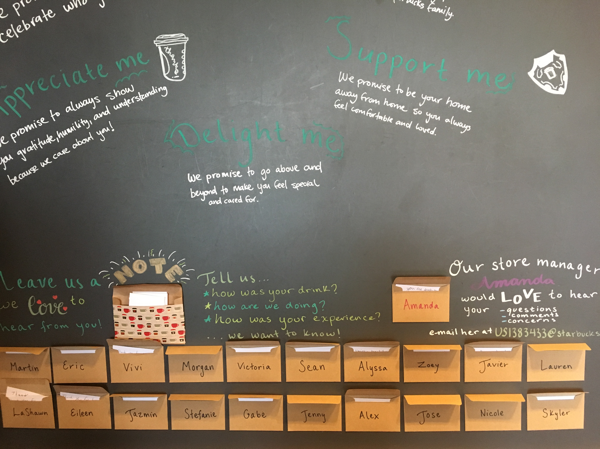
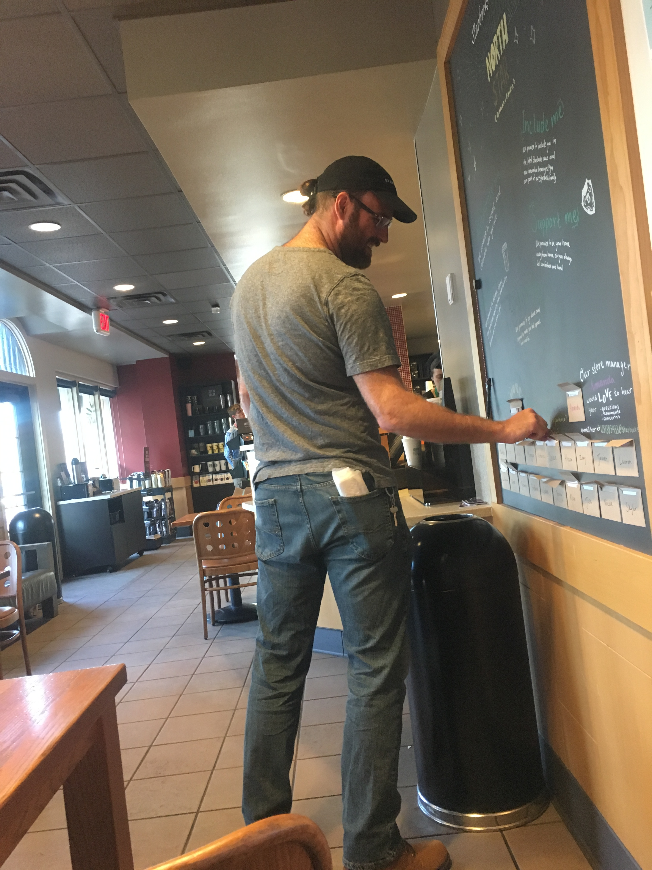
Thank you!

